Slide 1
Environmental challenges and solutions
Prof Sophie Nixon and Dr Vicky Coker
Week 10 Sustainable Planet 2025

Slide 2
Intended Learning Outcomes
Identify the range and environmental consequences of major industrial and natural disasters
Evaluate different remediation and mitigation strategies for environmental contamination and ecosystem recovery
Assess the role of legislation and engineering solutions in preventing future environmental disasters
Analyze case studies to identify key lessons learned and their implications for sustainable environmental management

Slide 3
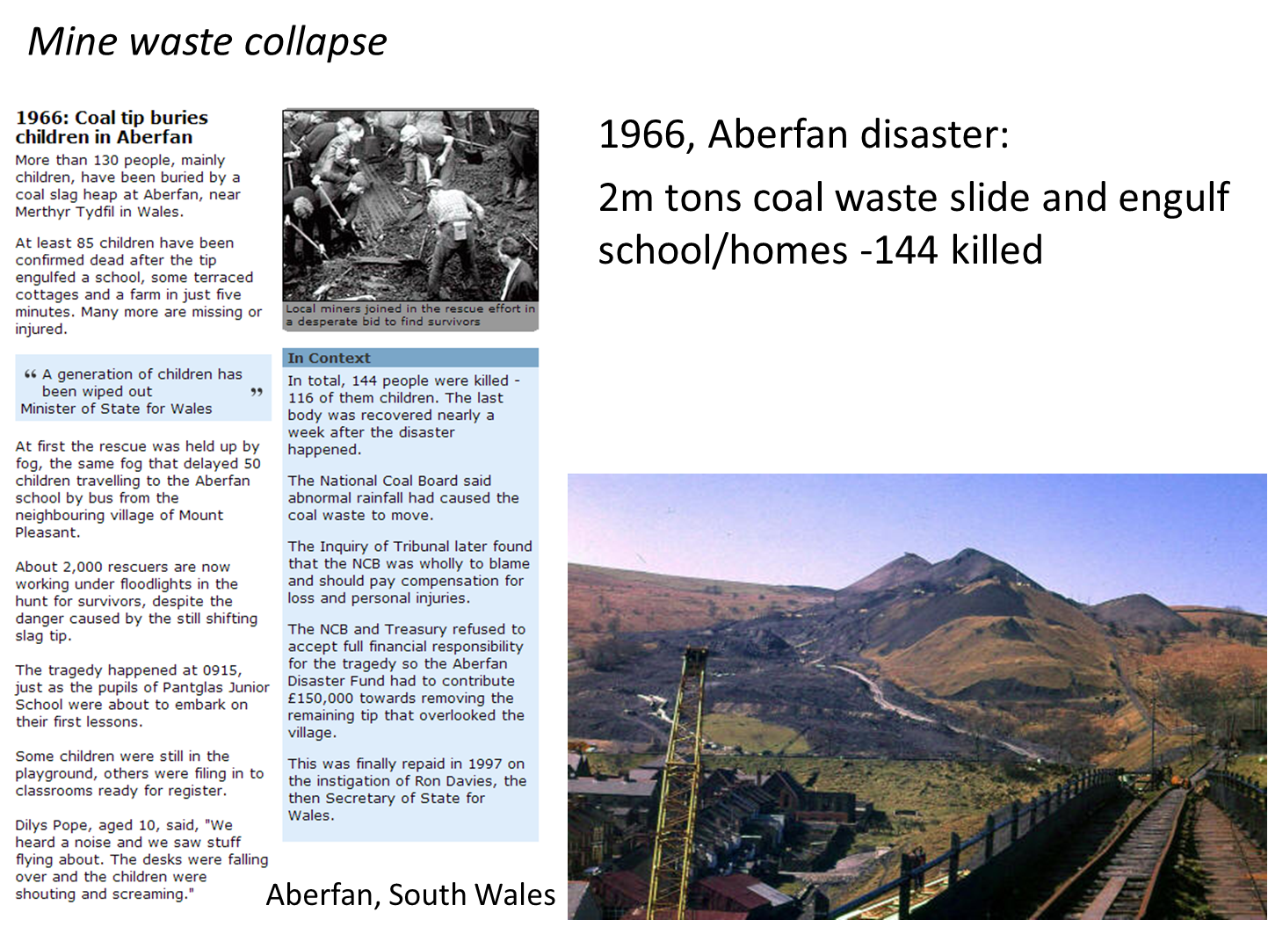
Coal: Mine Spoil Tip Collapse
Solutions
  Regulation
  Revegetation/reclamation
  Understanding of controlling factors
    physical, hydraulic, and mechanical characteristics
    climatic conditions
    slope geometry

Slide 4
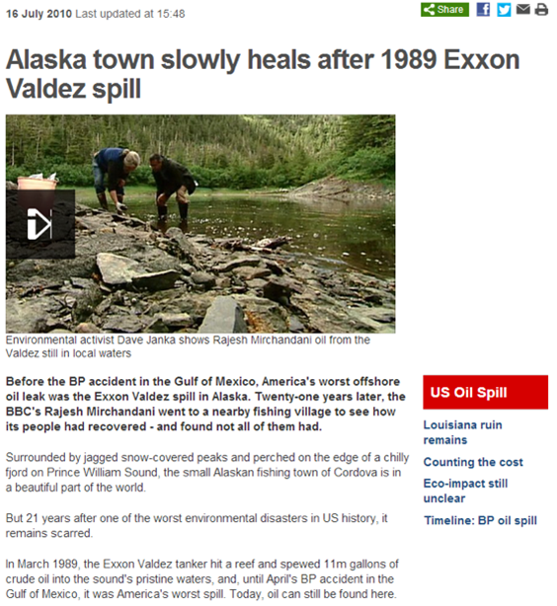
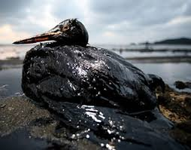
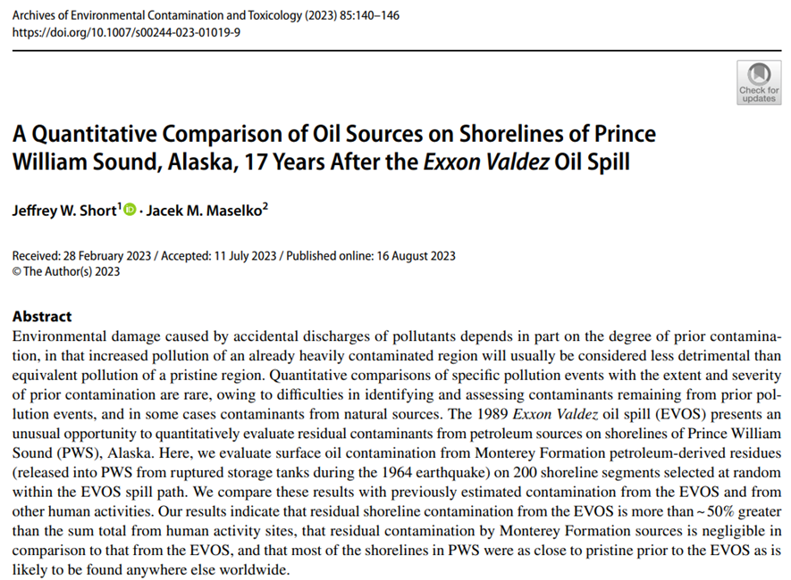
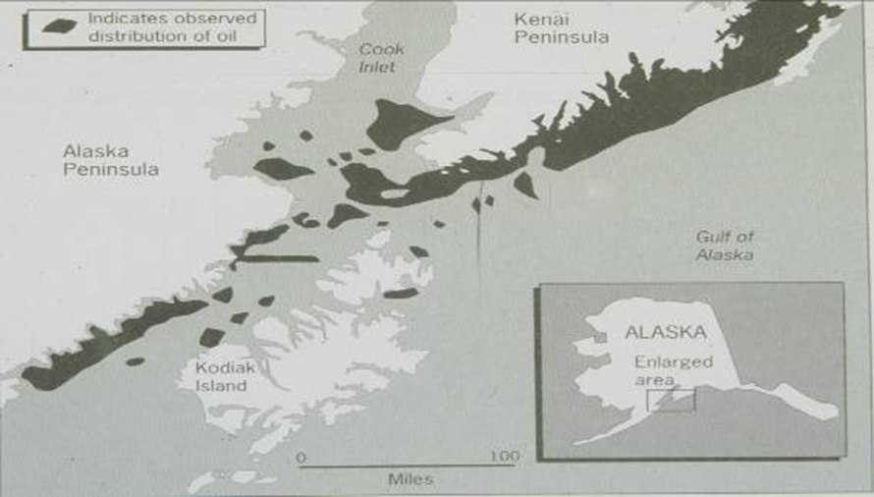
Oil: Exxon-Valdez Spillage, Alaska
Prince William Sound
11 million gallons (125 olympic swimming pools) over 800 km coastline
400,000 sea birds
4000 sea otters dead
$1 billion in fines, $100 million in research costs
RESULT: 1990 Oil Pollution Act (US) e.g. Double hulled oil tankers

Slide 5
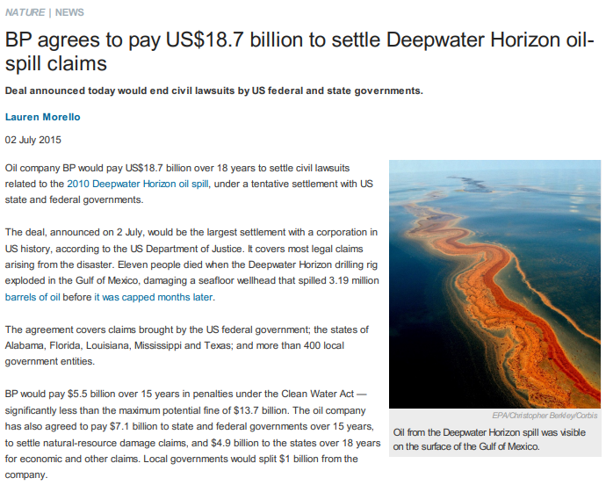
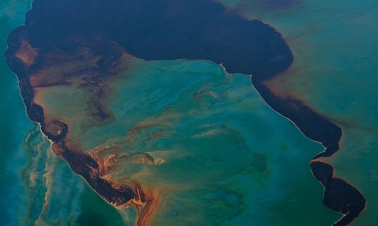
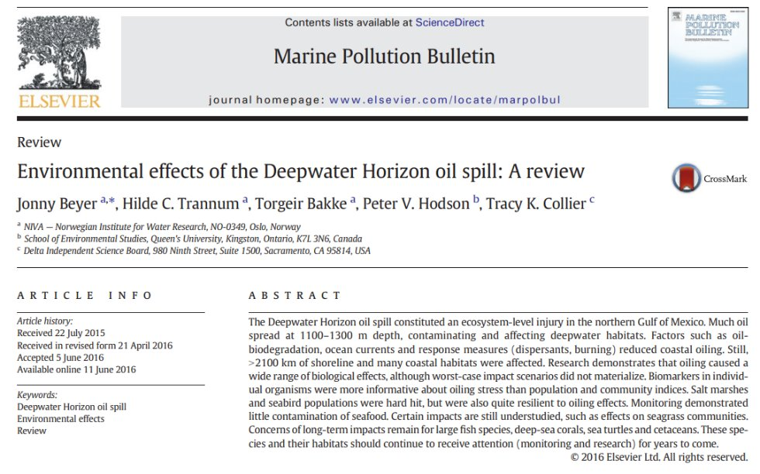
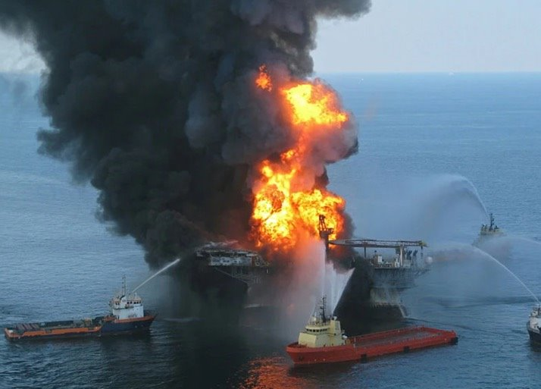
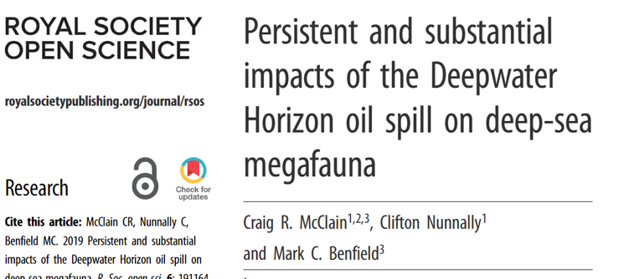
Oil: Deepwater Horizon Blow out
Gulf of Mexico oil rig operated by BP
11 people killed
780 million litres (300 olympic swimming pools)
BP oil spill
Notes:
Following the explosion and sinking of the Deepwater Horizon oil rig, a sea-floor oil gusher flowed for 87 days, until it was capped on 15 July 2010.^{[8][10]} The US Government estimated the total discharge at 4.9 million barrels (210 million US gal; 780,000 m³).^{[3]} After several failed efforts to contain the flow, the well was declared sealed on 19 September 2010.^{[11]} Some reports indicate the well site continues to leak.^{[12][13]}

Slide 6
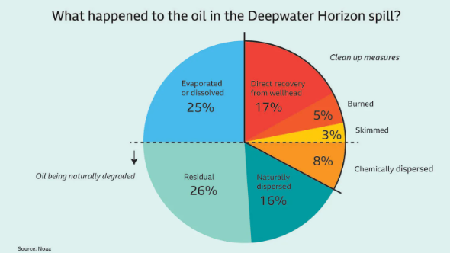
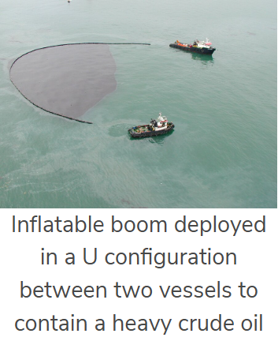
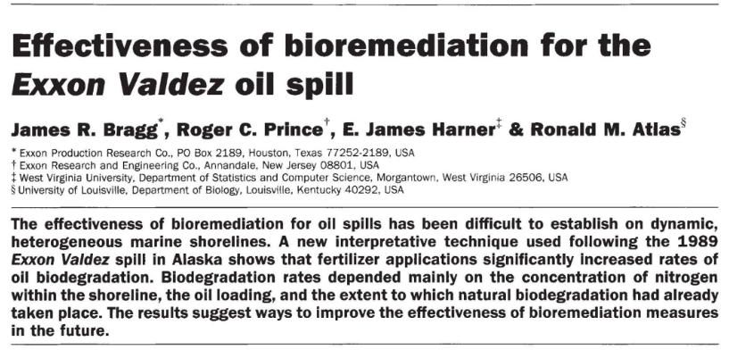
Oil spill solutions
Booms to prevent onward migration
Burning
Soaking up using e.g.
  Textiles
  Graphene
  Magnets
  Hair/fur
Skimming
  Vacuuming the surface
  Scoops/conveyor belts
Dispersants
  Breaks oil into smaller droplets
  Sinks or degrades more easily
Natural attenuation
  Evaporation
  Bioremediation
Nature paper

Slide 7
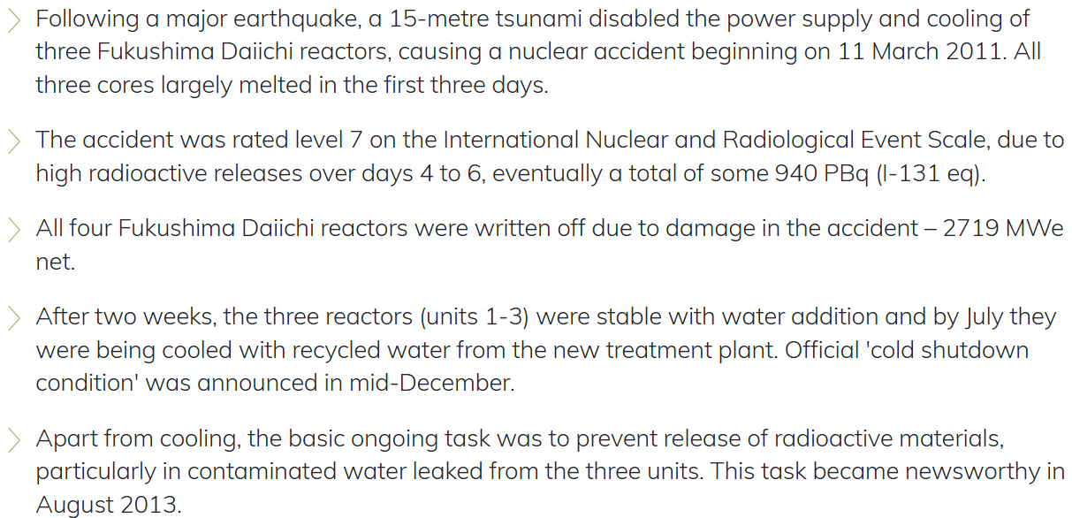
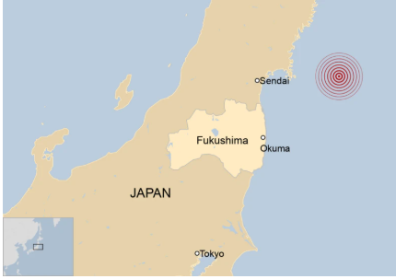
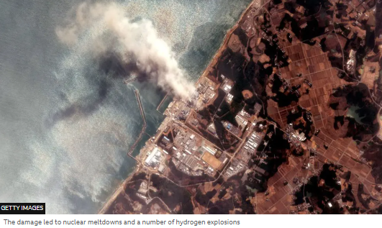
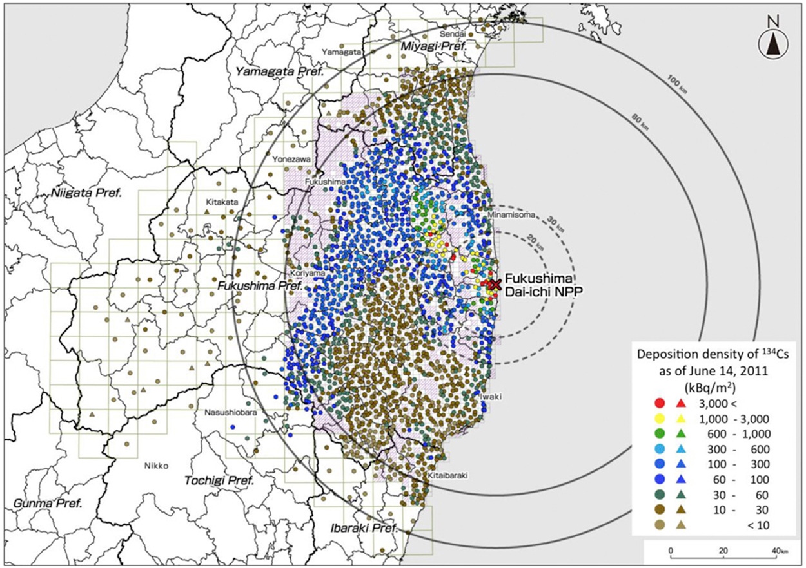
Nuclear: Fukishima Daiichi Accident, Japan, 2011
https://world-nuclear.org/information-library/safety-and-security/safety-of-plants/fukushima-daiichi-accident
https://www.sciencedirect.com/science/article/pii/S0265931X14000642
Notes:
Great East Japan Earthquake triggereda 15m tsunami damaged a nuclearpower plant
No deaths (or 1 death) or cases ofradiation sickness from the nuclearaccident, but over 100,000 peoplewere evacuated from their homes
Waste disposal and clean up is amassive challenge (2050+)

Slide 8
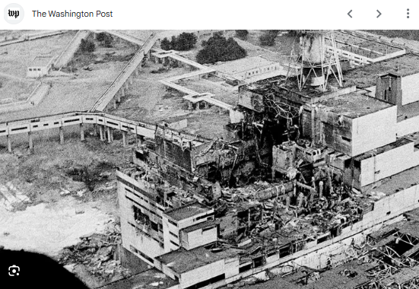
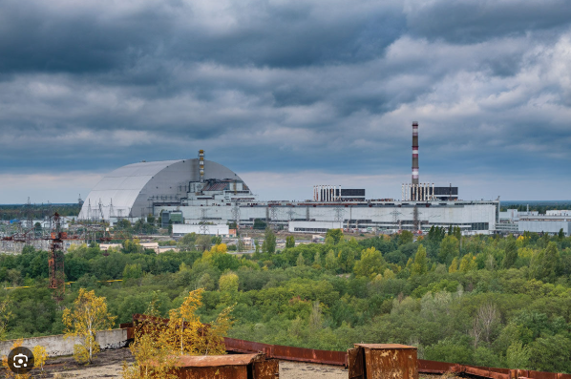
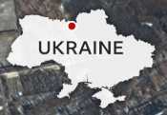
Nuclear: Chernobyl, 1986
Result of a flawed reactor design and lack of safety culture
steam explosion and fires released 5% of the reactor core into the environment, with the deposition of e.g. Sr, Cs and I
only accident where radiation-related fatalities occurred
New Safe Confinement (NSC) structure was completed in 2017
sealed building allows remote dismantling of 1986 structure and removal of the fuel-containing materials

Slide 9
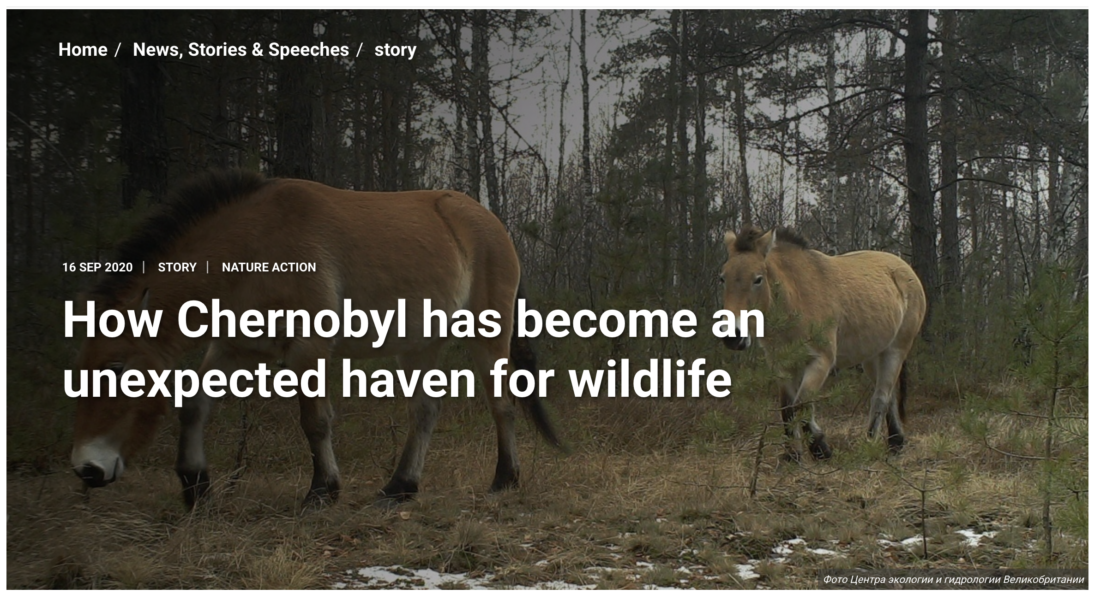
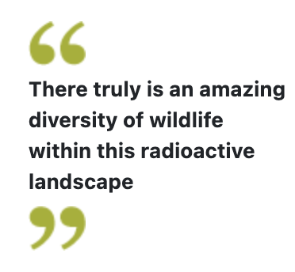
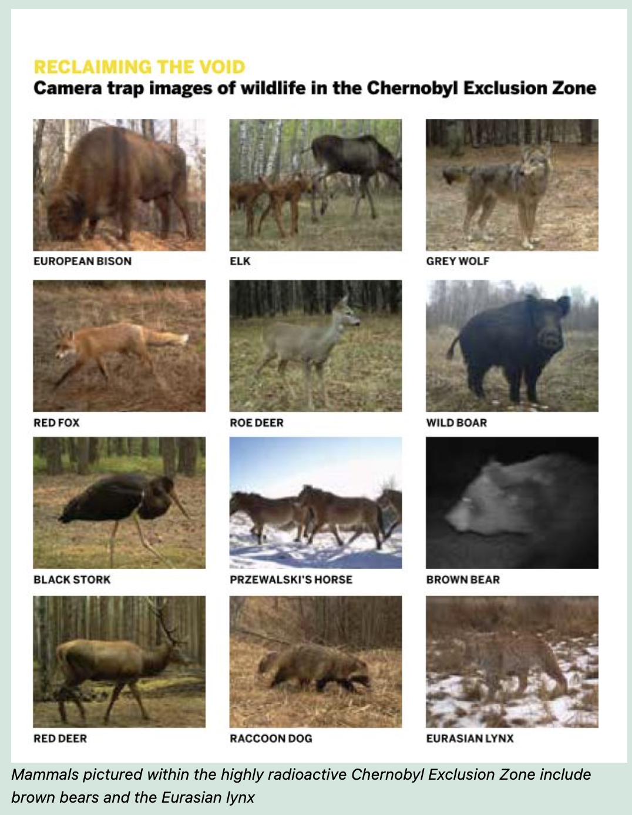
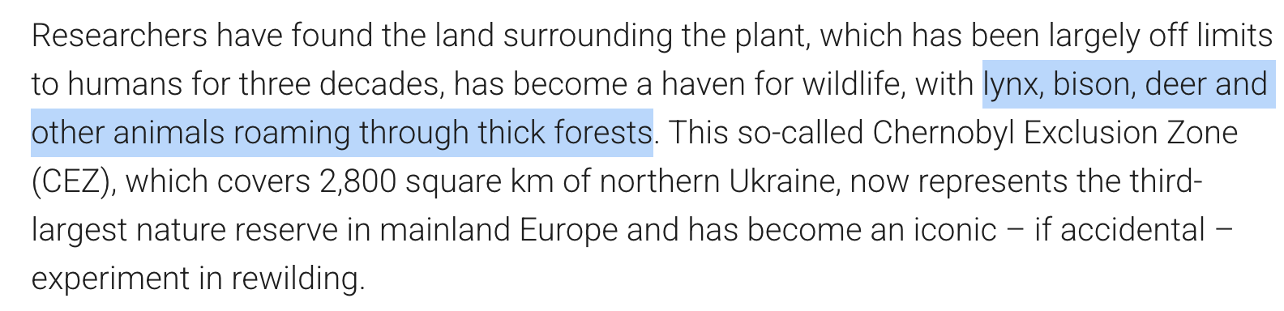
Nuclear: Chernobyl today
https://thebiologist.rsb.org.uk/biologist-features/out-of-the-ashes

Slide 10
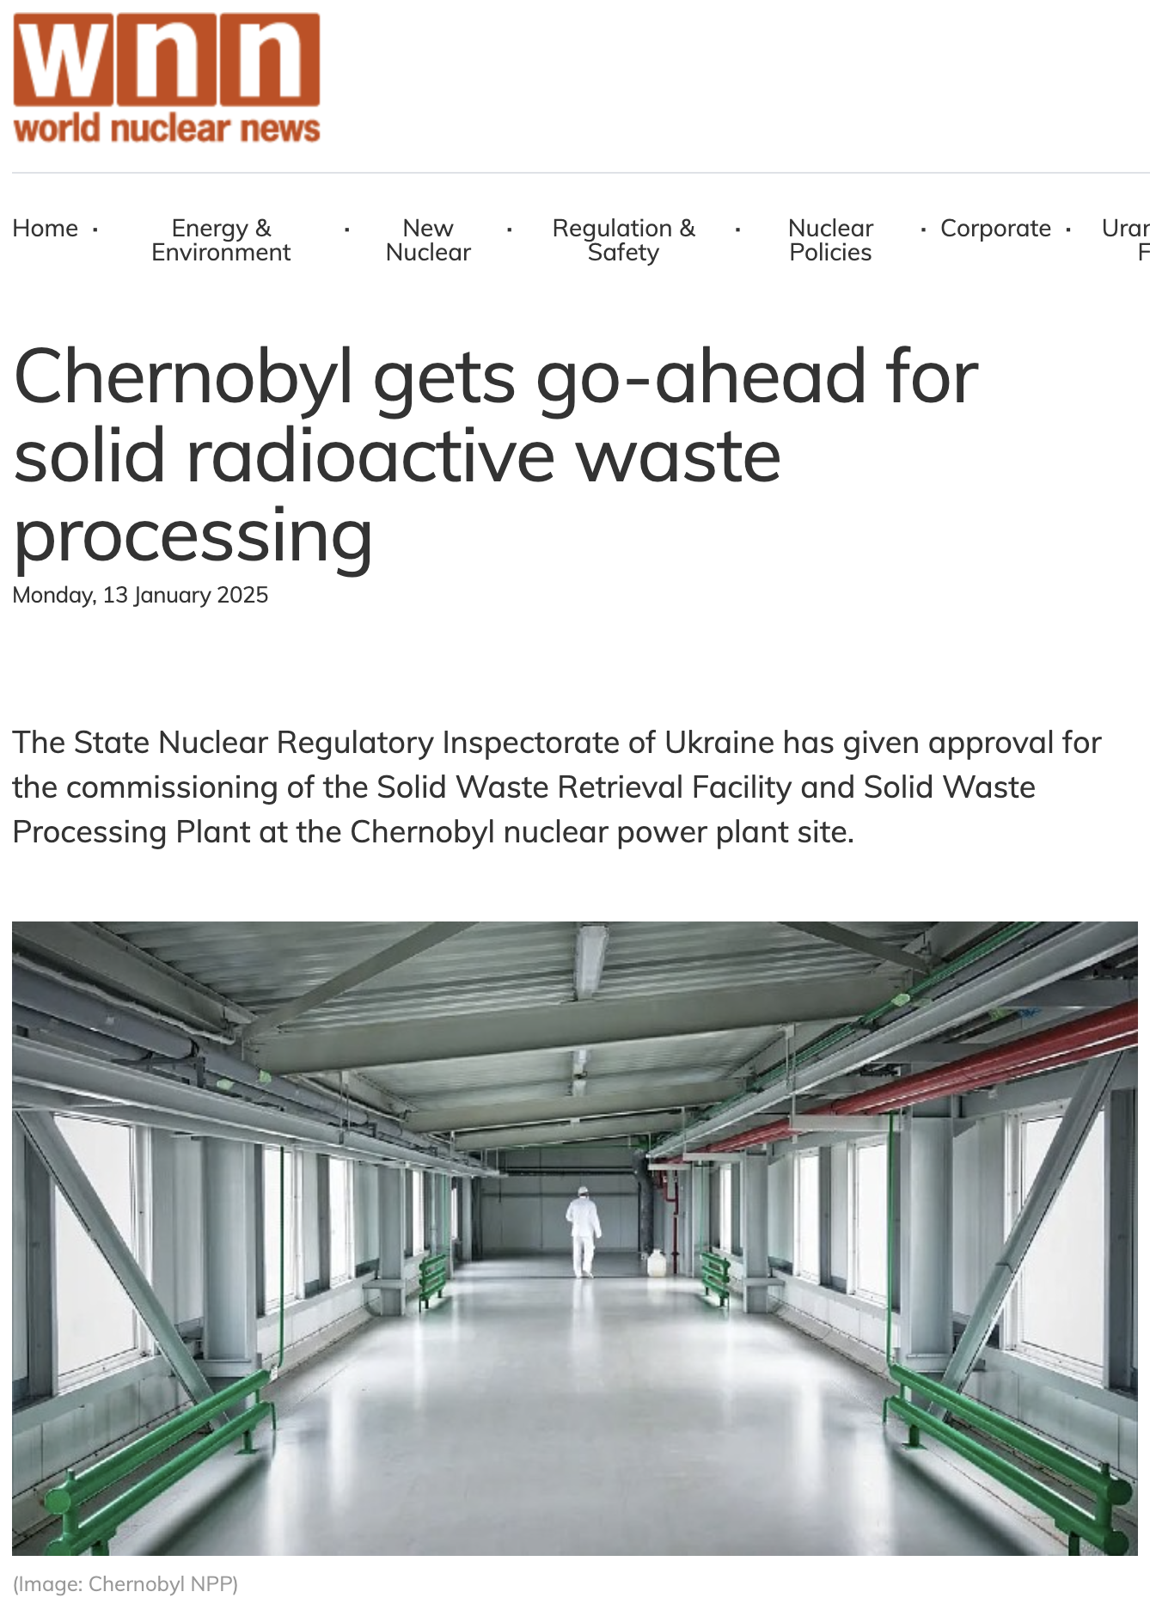
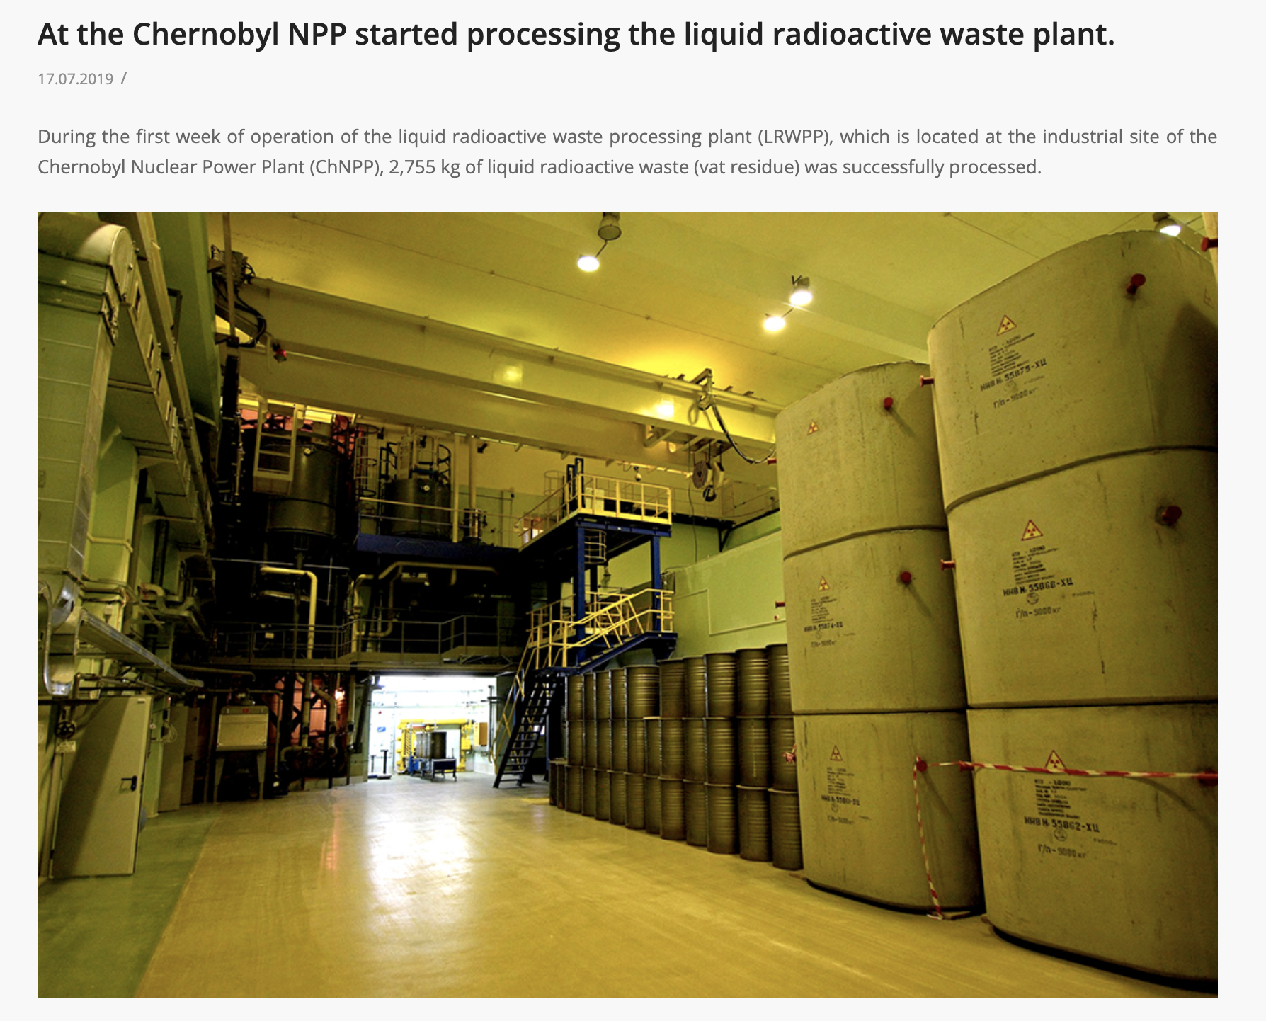
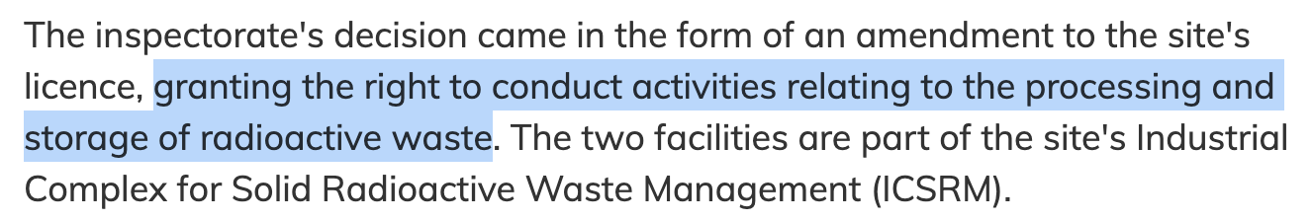
Nuclear: Chernobyl today

Slide 11
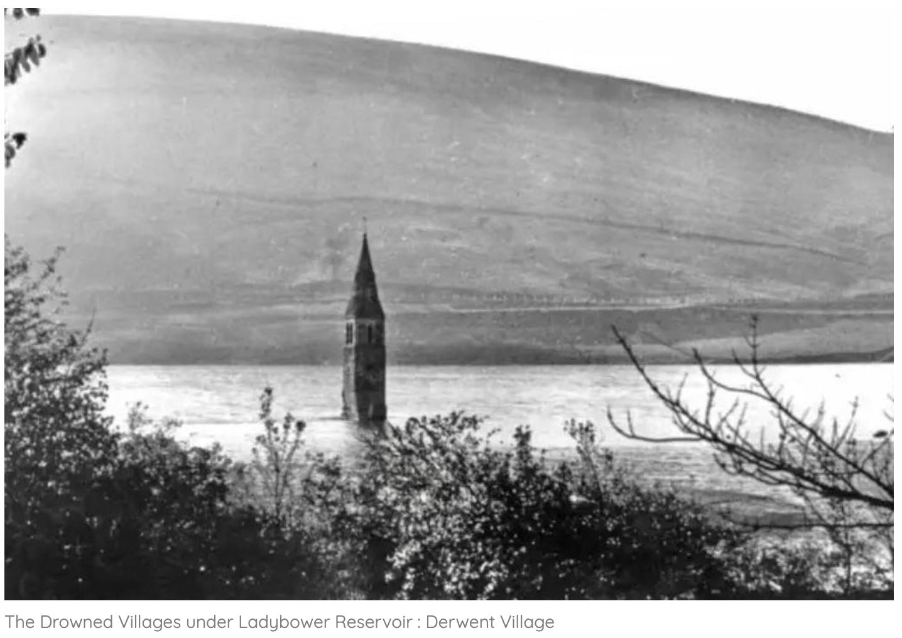
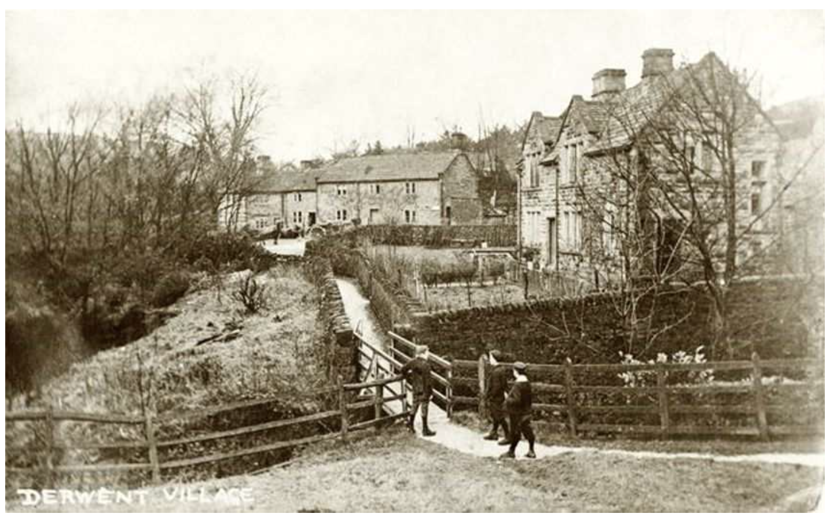
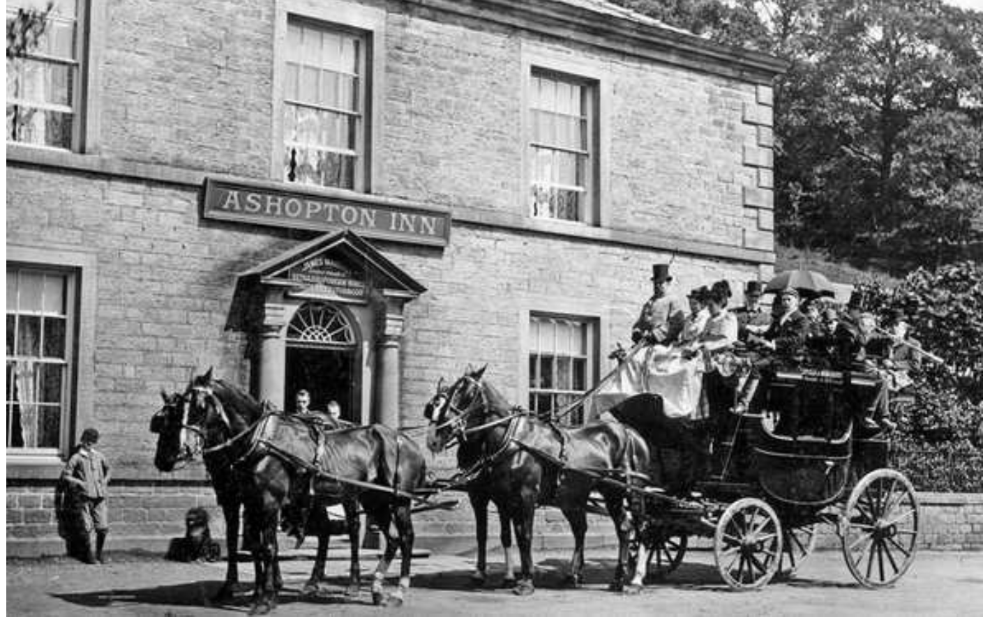
Hydroelectric power

Slide 12
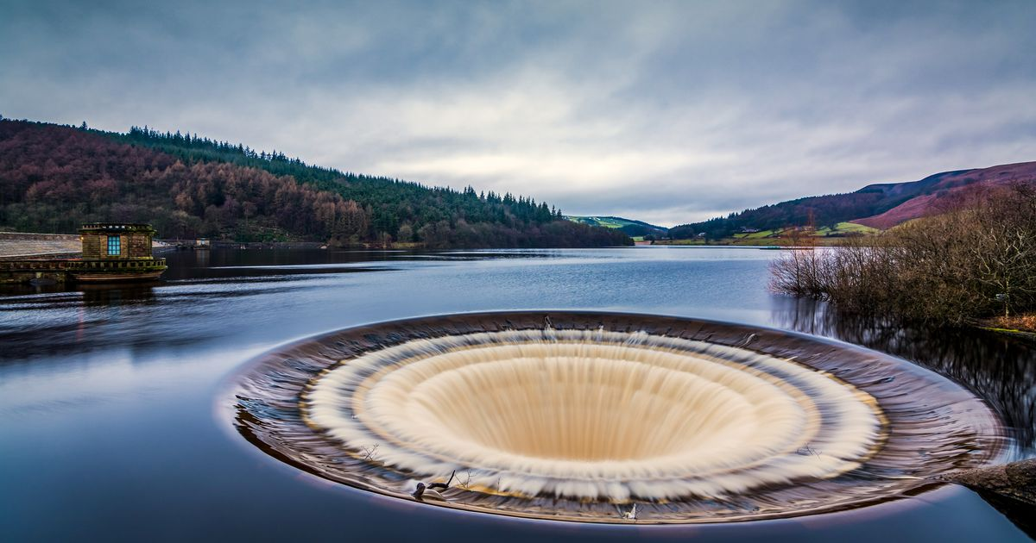
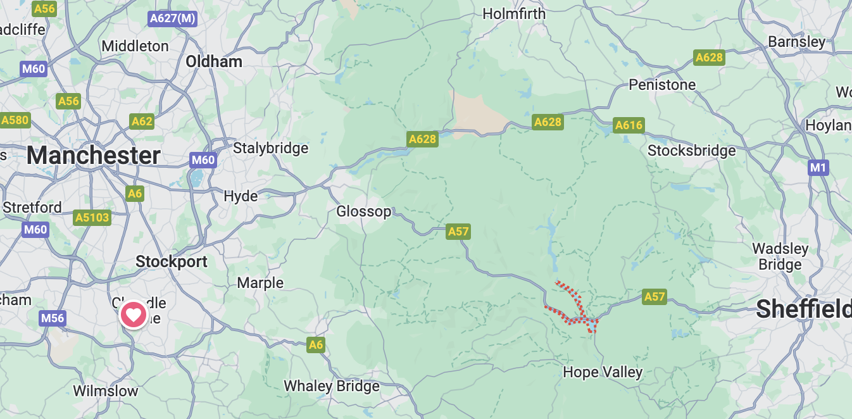
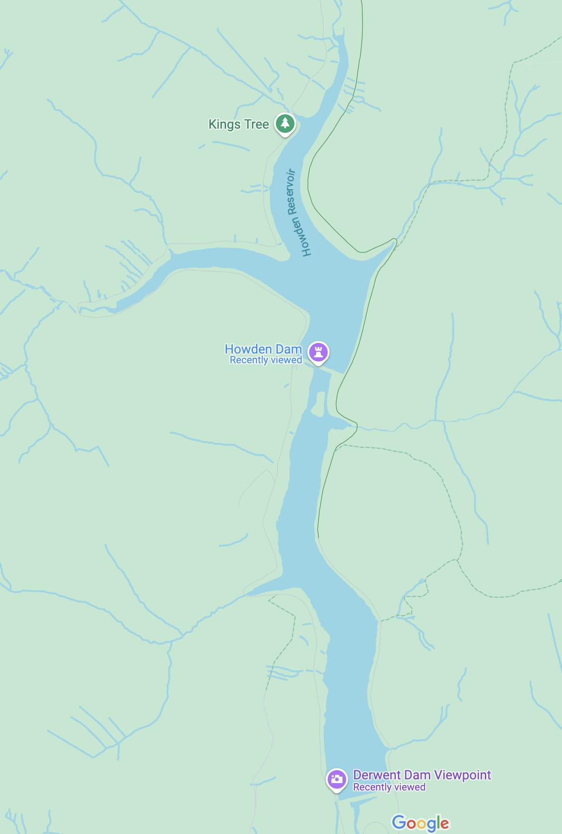
Hydroelectric power
Not only displacement of people...

Slide 13
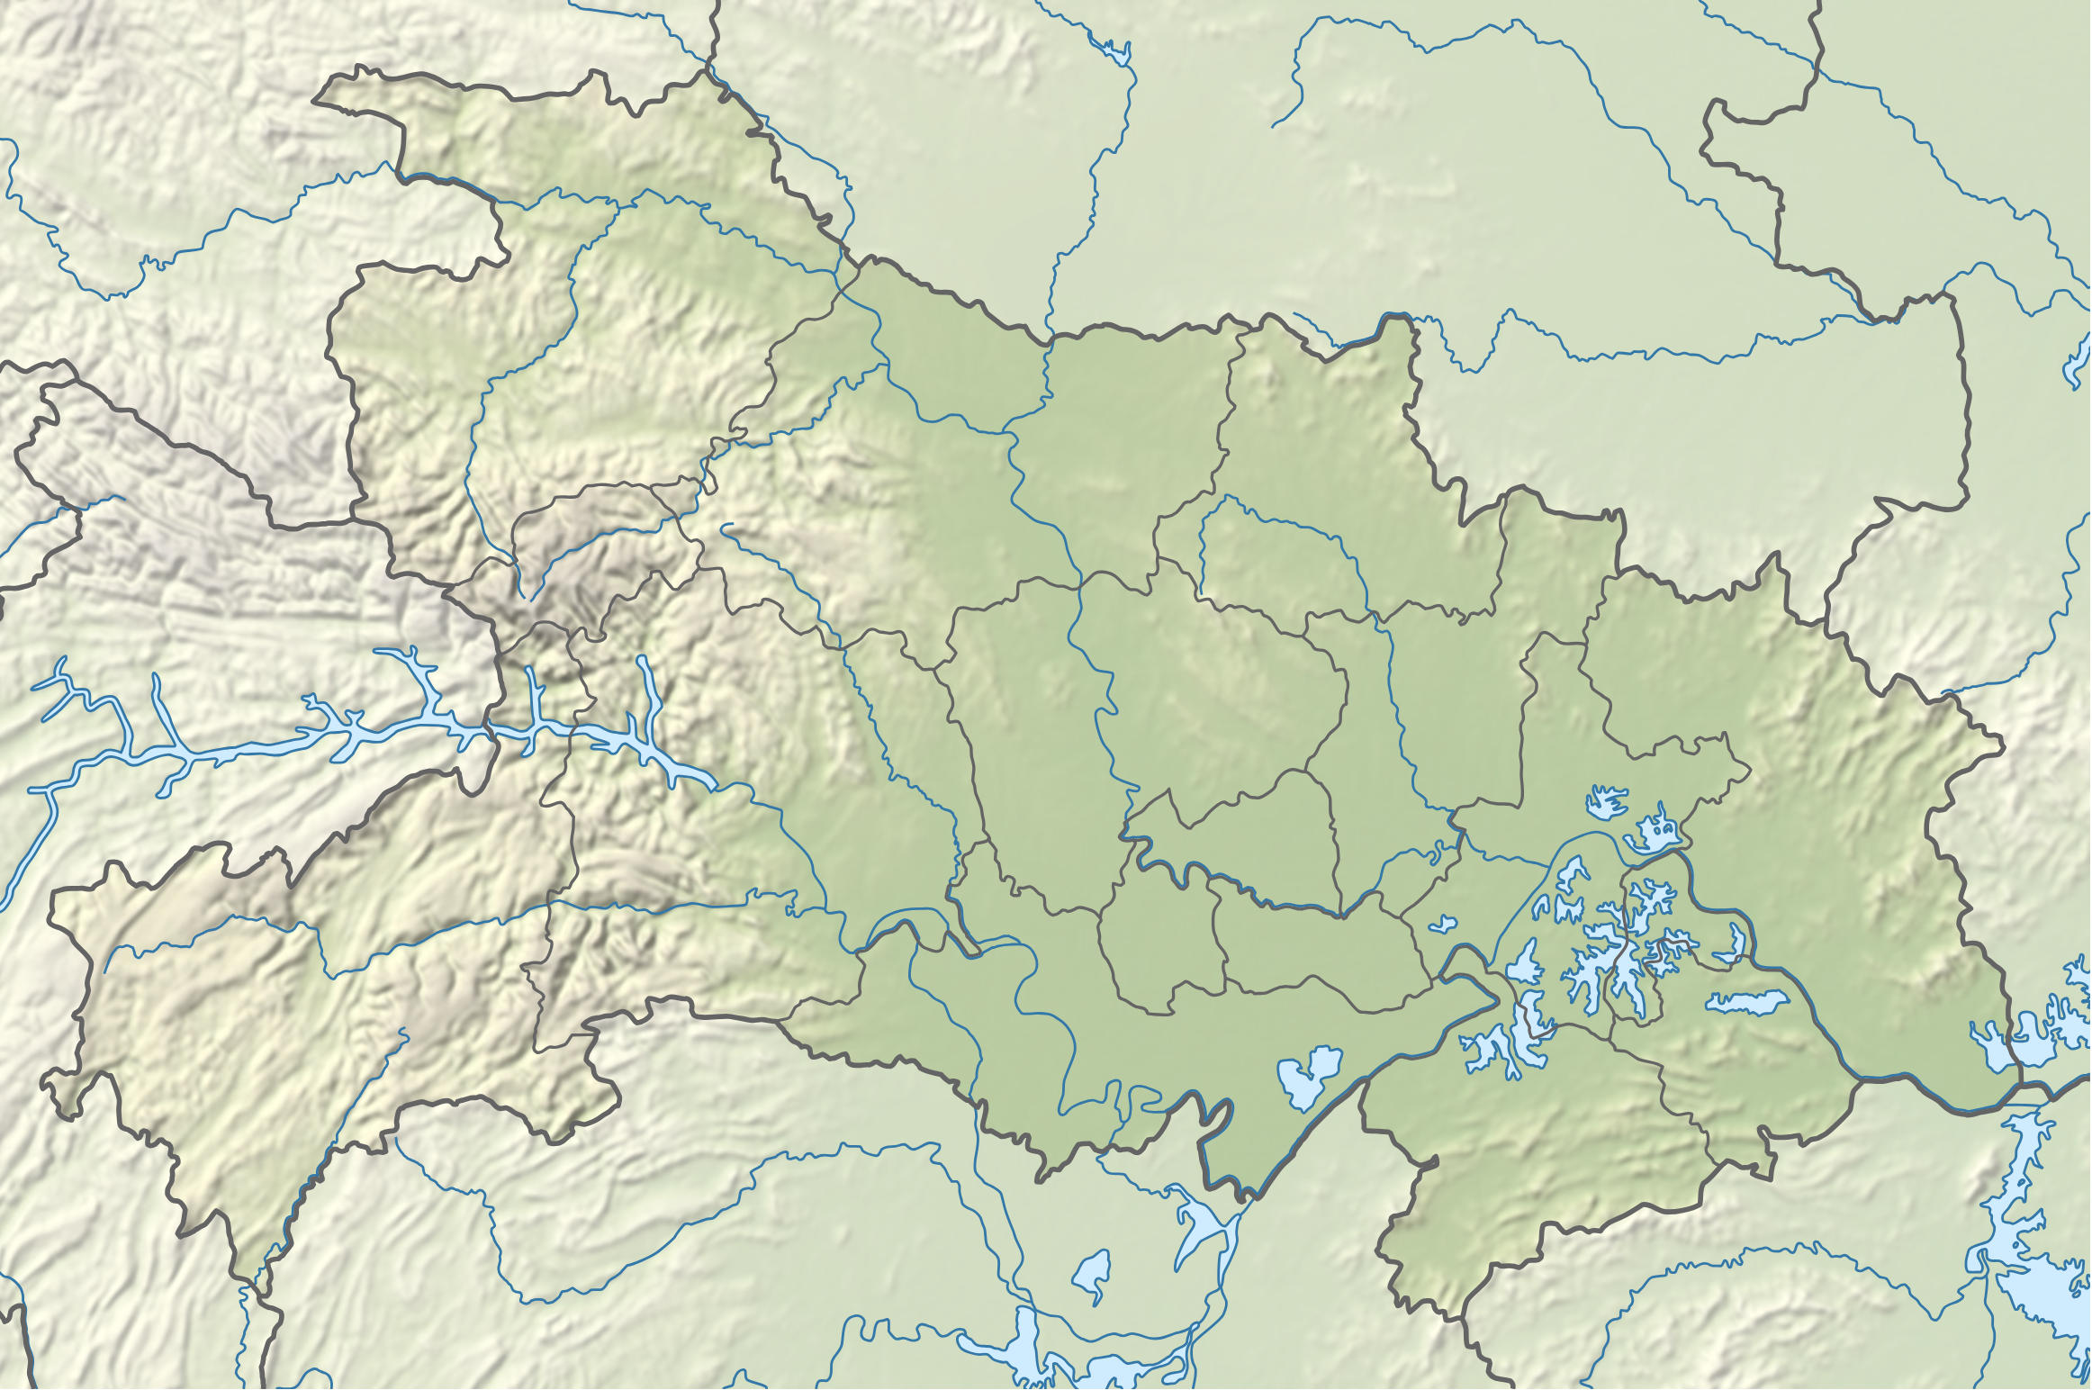
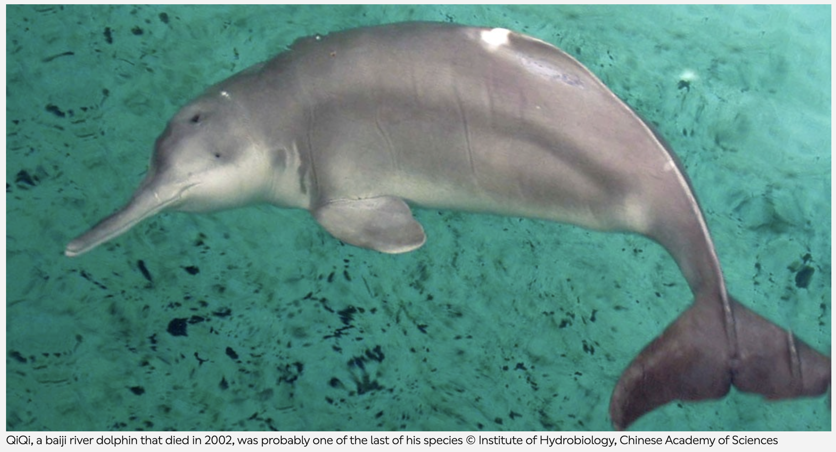
Hydroelectric power: Three Gorges Dam
The Yangtze River dolphin (baiji) is now functionally extinct, with damming contributing to habitat loss and population fragmentation
Many river systems support unique endemic species that are highly adapted to specific flow conditions. Altering these environments can lead to extinction or genetic bottlenecks.

Slide 14
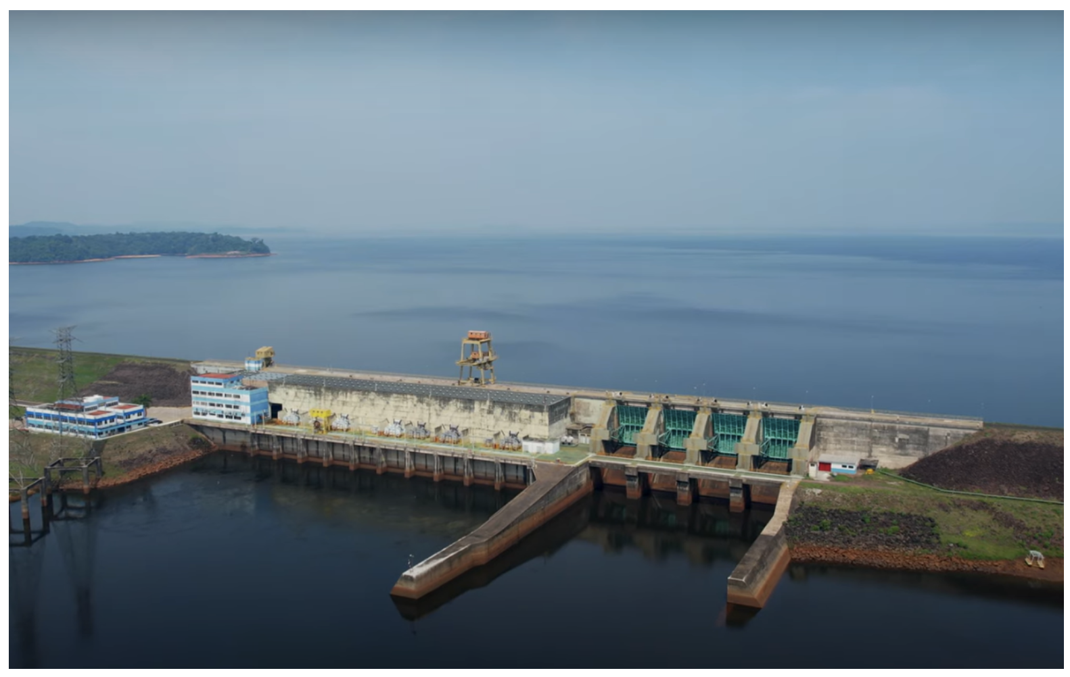
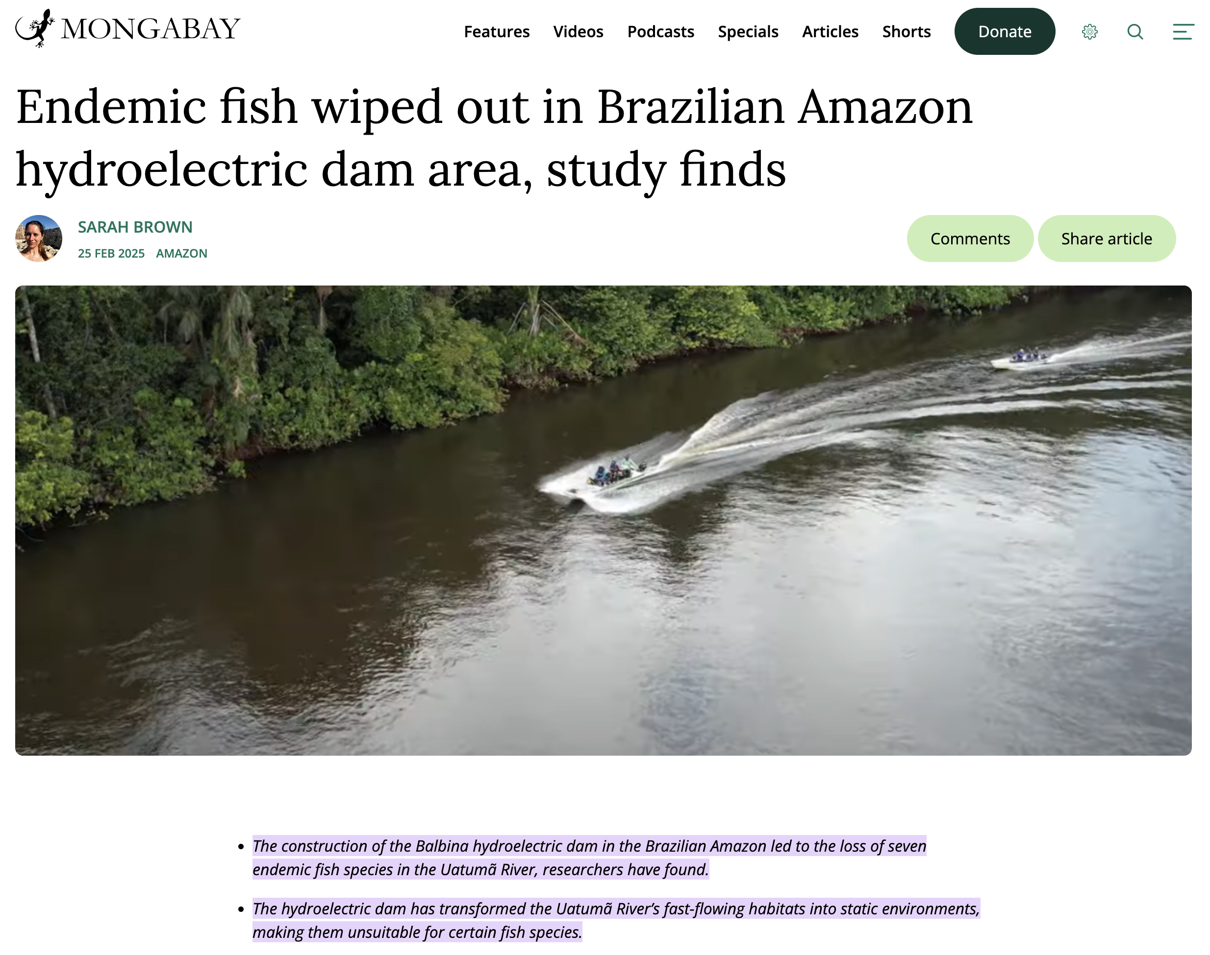
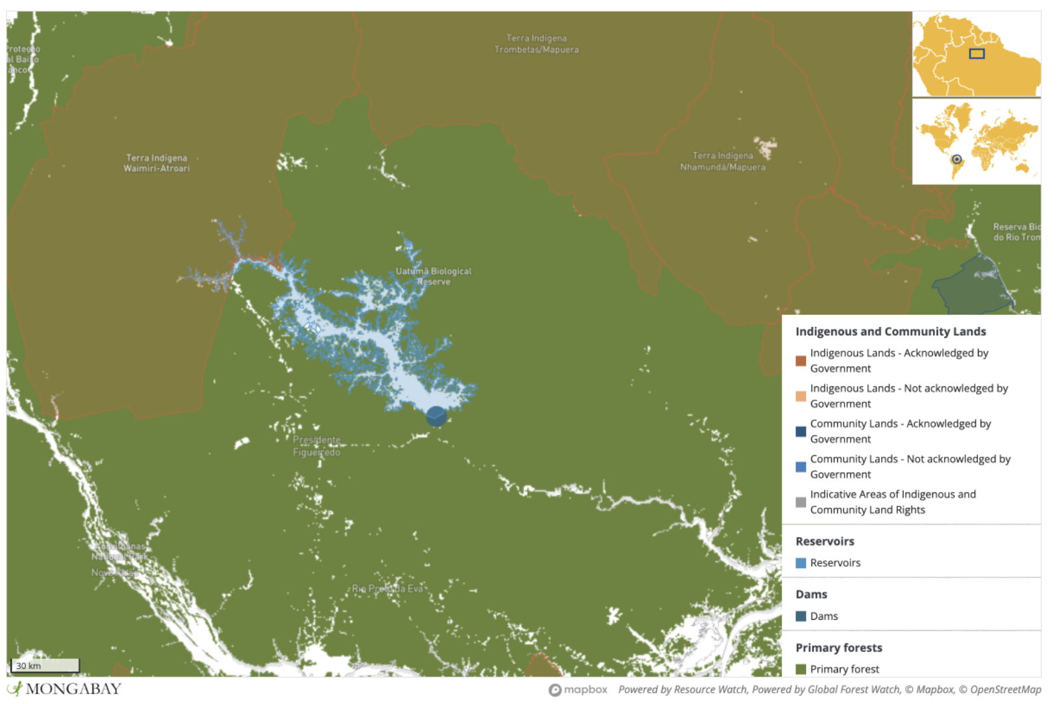
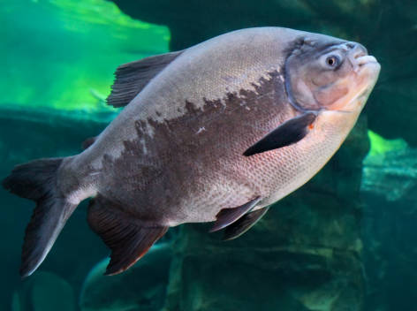
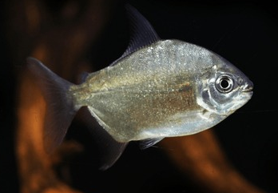
Hydroelectric power: Balbina
The creation of the Balbina Dam in the Brazilian Amazon flooded ~2,400 km² of rainforest, leading to severe biodiversity loss and the isolation of species on artificial islands

Slide 15
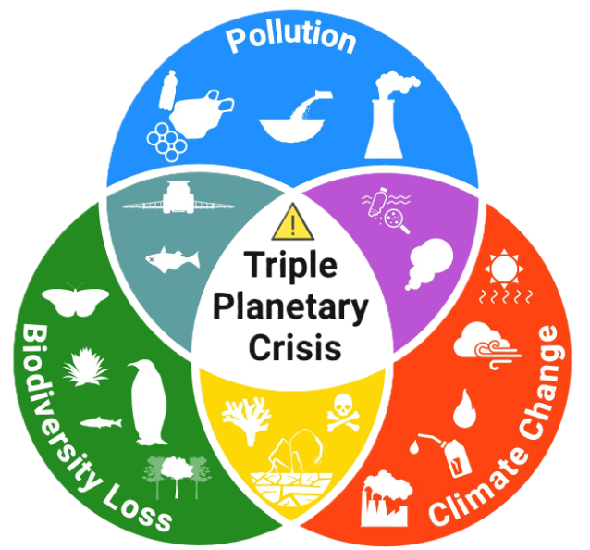
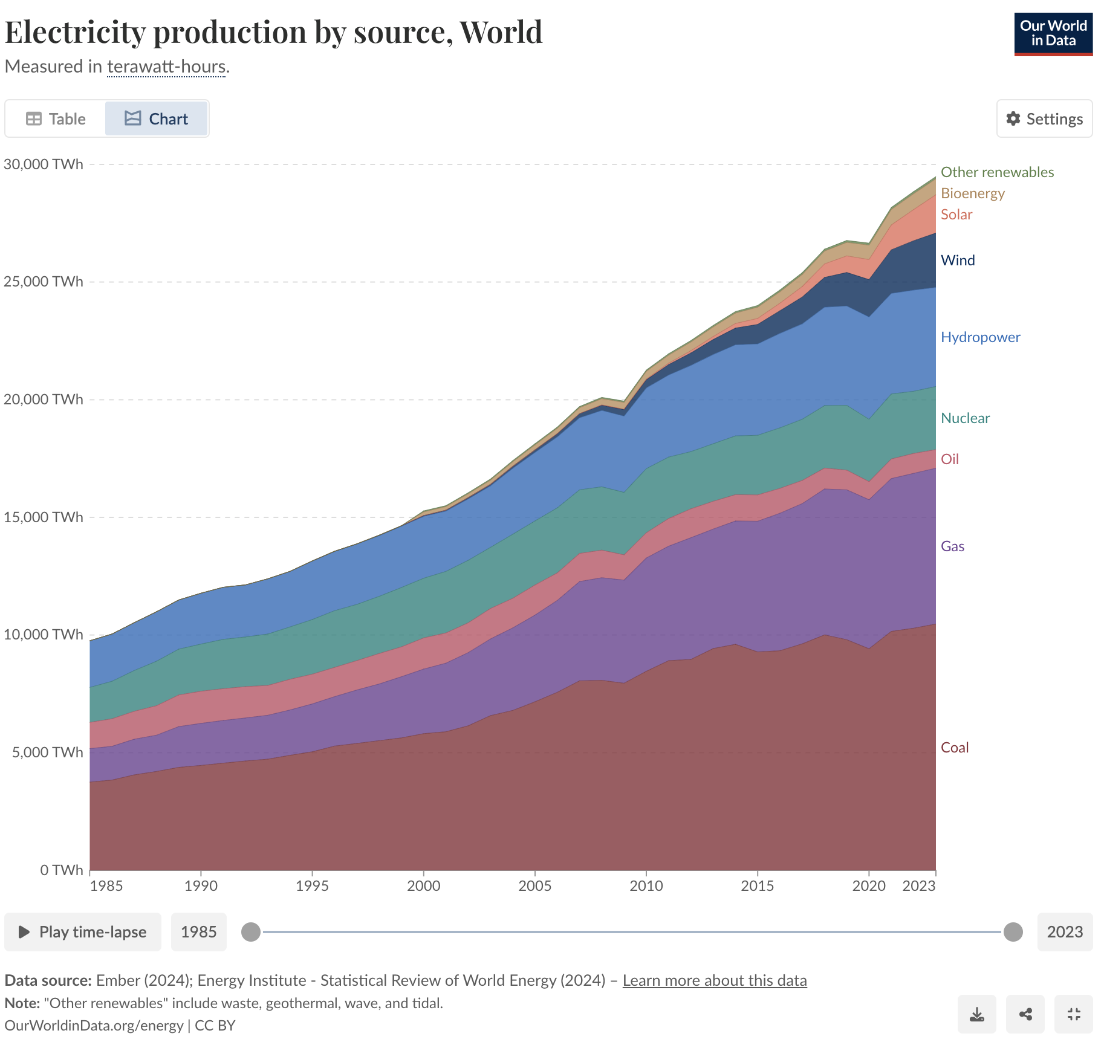

Solving one problem exacerbates another

Slide 16
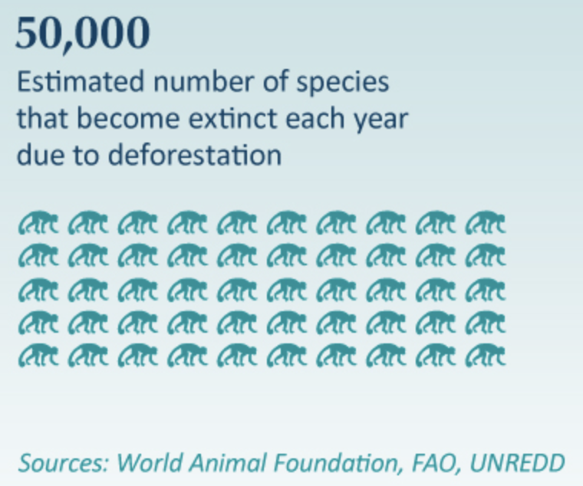
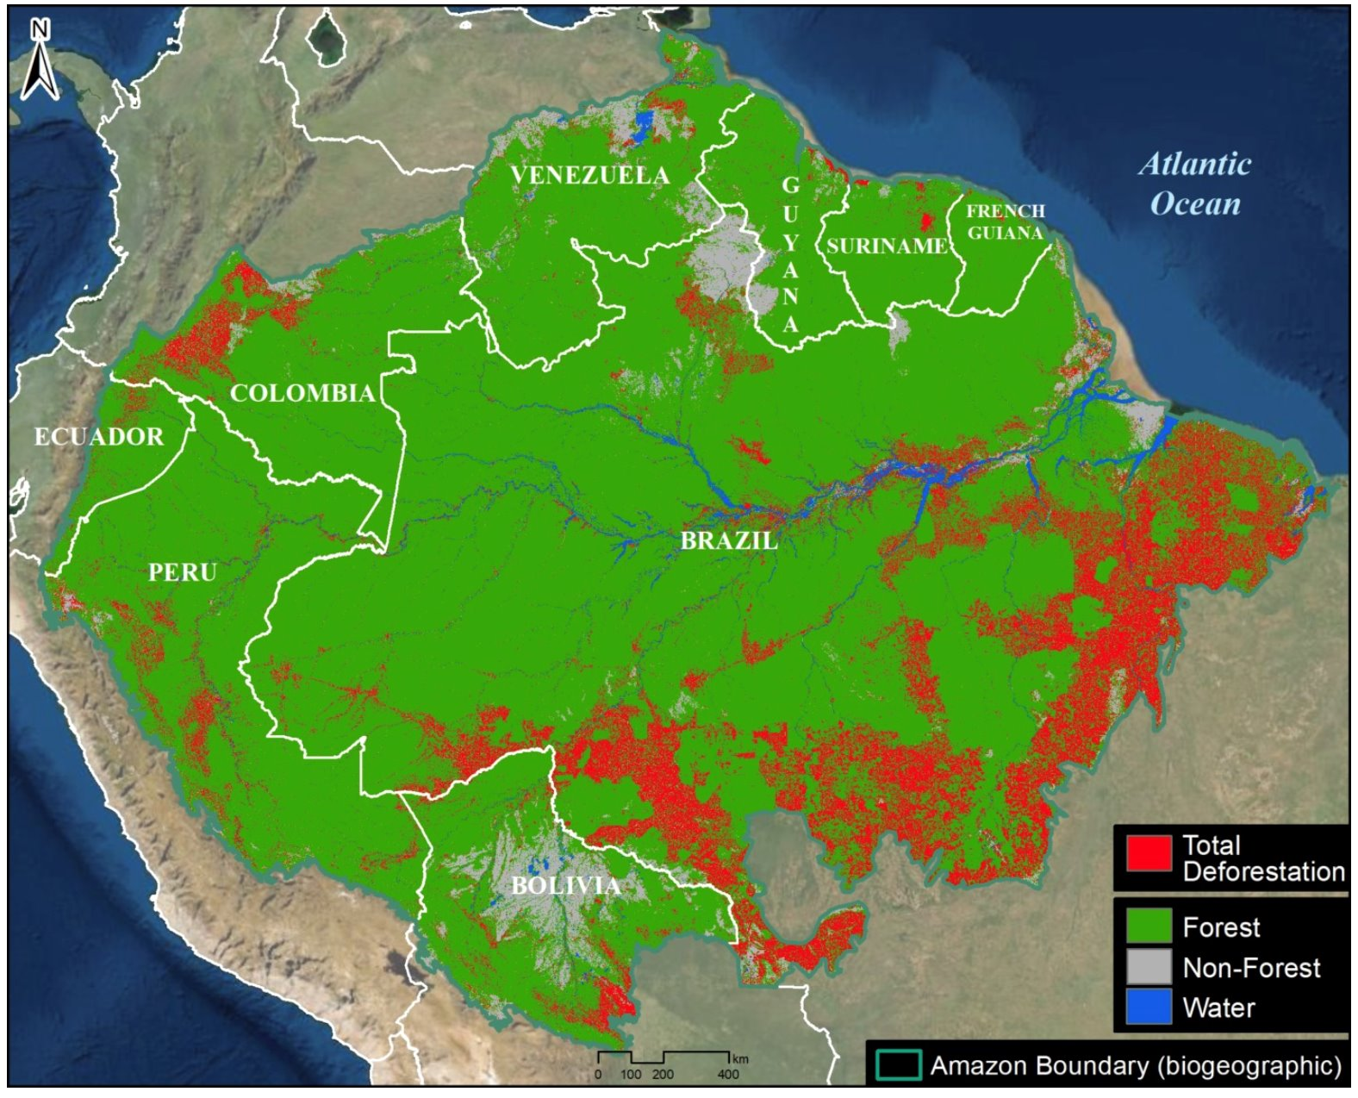
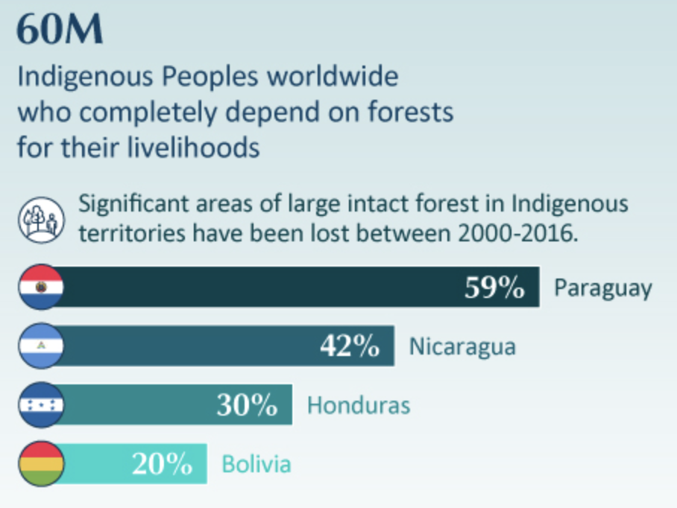
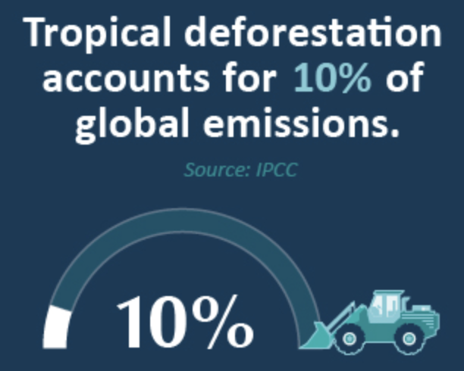
Deforestation: Amazon rainforest

Slide 17
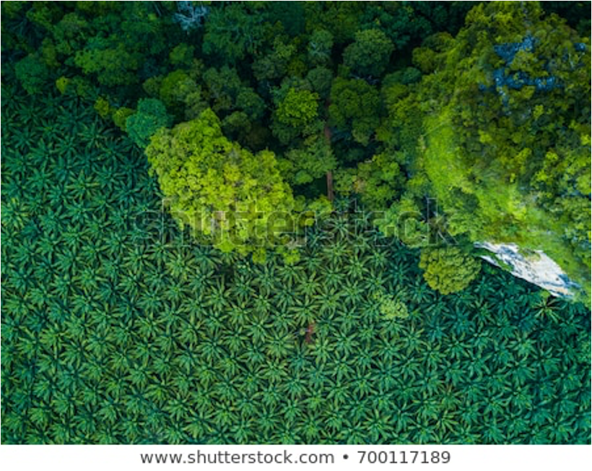
Deforestation: Amazon rainforest

Slide 18
Tipping points of Biodiversity
Mammal, amphibian, and invertebrate richness decreases with logging intensity
Increases in bird species richness are caused by the influx of habitat generalists
Logging intensity of 38 m³ ha⁻¹ would cause halving of mammal richness
Logging intensity of 63 m³ ha⁻¹ would cause halving of amphibian richness
https://doi.org/10.1016/j.cub.2014.06.065
Notes:
Logging causes huge impacts on biodiversity….with huge potential to affect ecosystem functioning Some groups of animals reach thresholds or tipping points beyond which change is irreversible. Perhaps logging can be managed to ensure the survival of some key biodiversity groups? But we need to know what these thresholds are and be able to police the logging

Slide 19
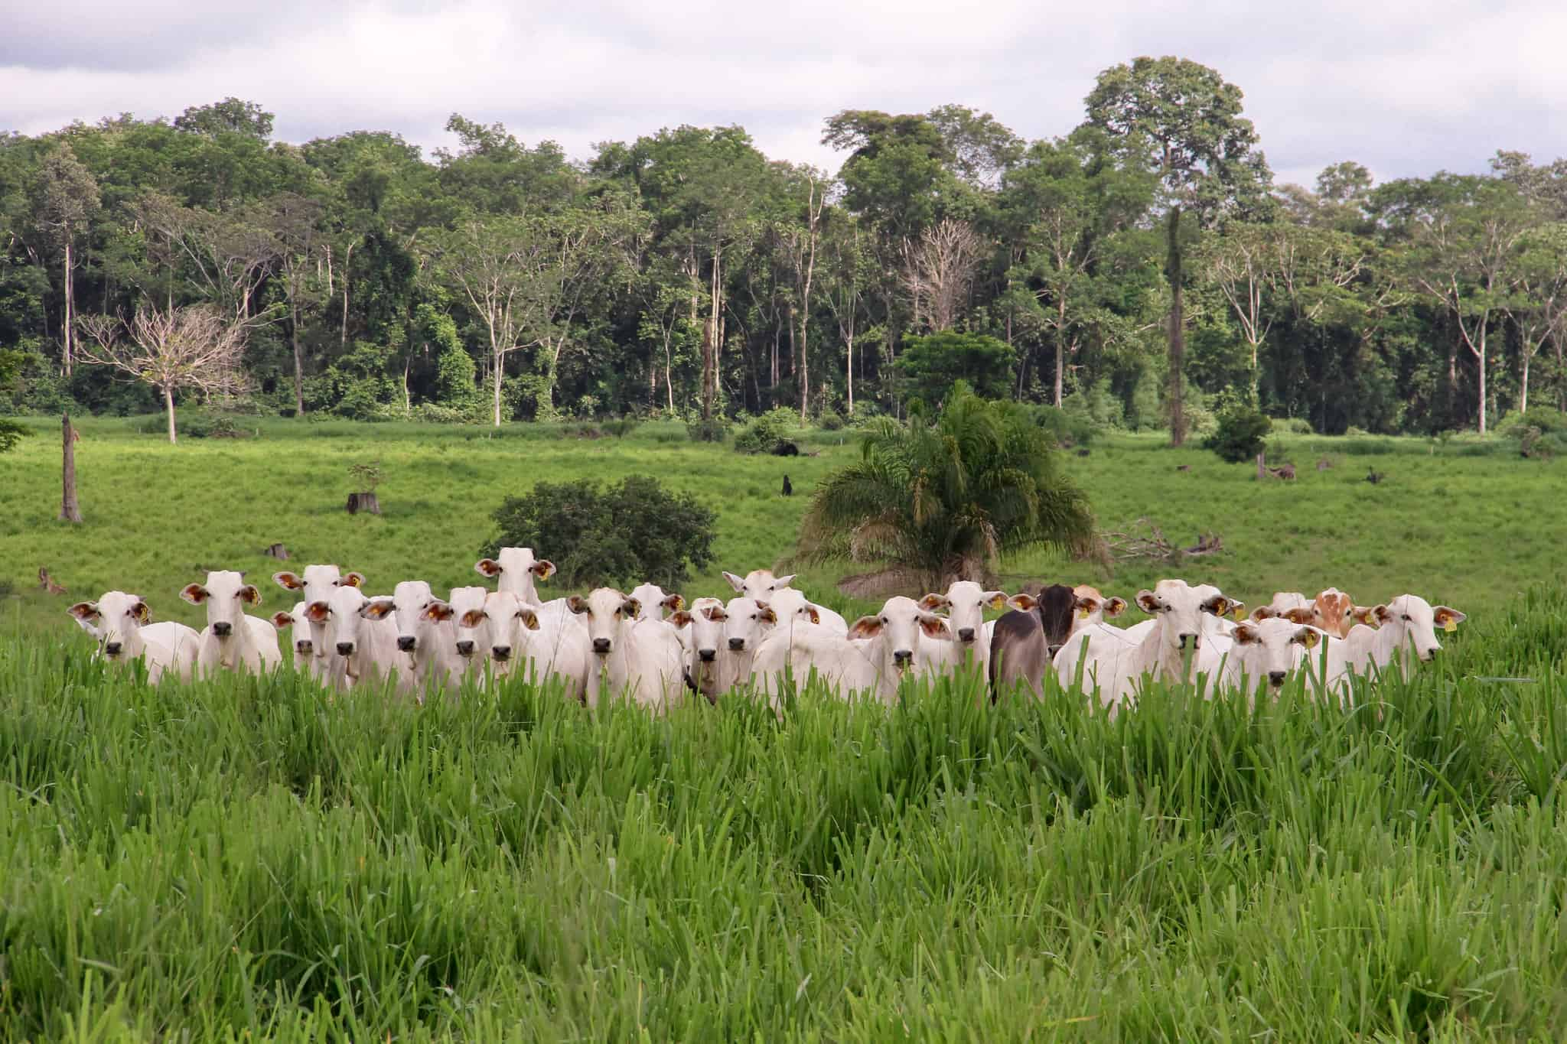
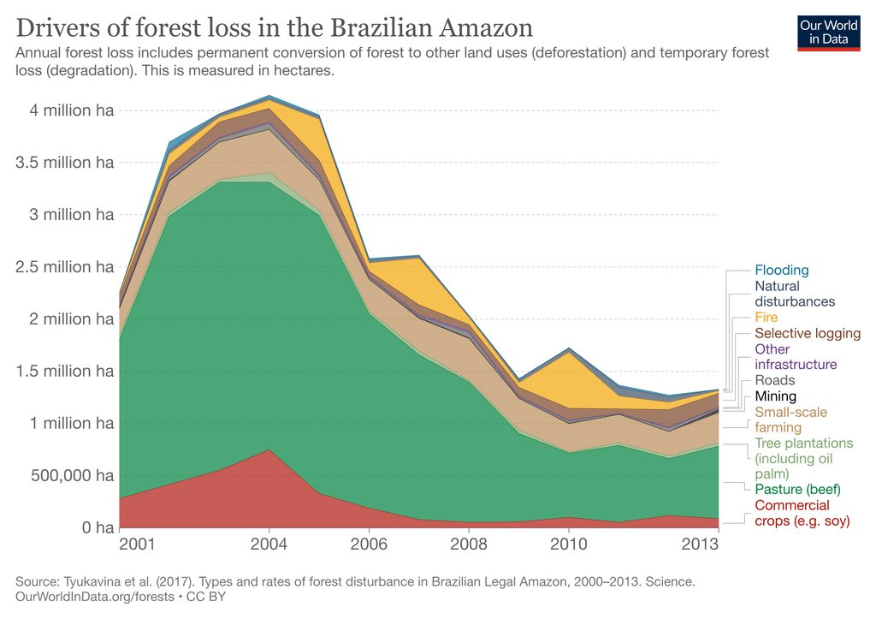
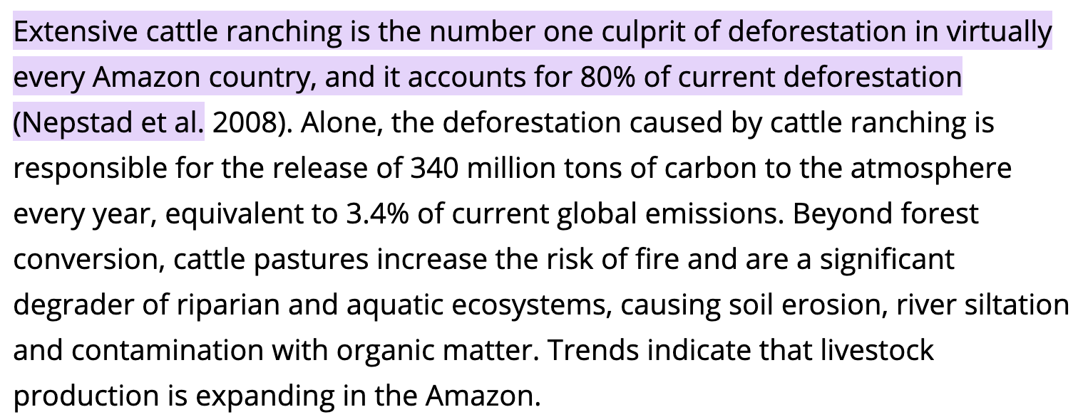

Deforestation: Amazon rainforest

Slide 20


Deforestation: Amazon rainforest

Slide 21

Eutrophication

Slide 22





Eutrophication from space

Slide 23


Eutrophication: Gulf of Mexico Dead Zone
One of the world’s largest hypoxic zones, fed by nutrient runoff from the Mississippi River Basin, mostly due to agriculture in the Midwest
Massive fish kills, harm to shrimping industry

Slide 24


Mining: Open cast
Ecosystem destruction
Land reclamation and legislation
https://www.sciencedirect.com/science/article/pii/S0012825217305925

Slide 25


Land reclamation: China Clay Pit -Eden Project, UK

Slide 26


Mining: Underground
Mine collapse
Lily Gold Mine, Barberton
South Africa
2016 collapse of the crown pillar
3 people died and mine remains closed

Slide 27




Mining: Closure
Acid Mine Drainage (AMD)
Occurs at abandoned mine sites where groundwater is no longer pumped out of the mine
Produced when Fe sulfide minerals are exposed to oxidation (water and/or air/bacteria)
Form sulfuric acid, sulfate compounds and iron oxides
Pyrite occurs with many coals

Slide 28




AMD: Rio Tinto, Spain
Rio Tinto mining area in Spain has experienced severe acid mine drainage due to extensive historical sulfide mining, leading to long-term water and soil contamination
https://digitalcommons.usf.edu/cgi/viewcontent.cgi?article=1157&context=gly_facpub#:~:text=Abstract%20Mining%20of%20massive%20sulfide,the%20New%20World%20in%201492.
Notes:
https://link.springer.com/article/10.1007/s002549900096

Slide 29


Slide 30

AMD remediation

Slide 31


Mining: Tailings
Brumadinho dam failure (Minas Gerais, Brazil) 2019
12 million m3 of iron ore tailings
270 people died
Ba, Pb, As, Sr, Fe, Mn and Al, have high mobility from the tailings to water
In the water, the levels of Fe, Al, Mn, Zn, Cu, Pb, Cd and U were higher than those allowed by Brazilian legislation.
In the sediments, Cr, Ni, Cu and Cd levels were higher than the established sediment quality guidelines (TEL-NOAA)

Slide 32



Mining: Processing
Ajka Alumina Plant, Hungary 2010 ‘Red Mud’
700,000 m³ of highly caustic red mud slurry escaped a containment facility
10 people died and contamination inundated several towns

Slide 33


Slide 34
Summary
Industrial and Natural Disasters – mining accidents, oil spills, nuclear incidents, hydroelectric power impacts, deforestation, eutrophication, and mining-related issues
Environmental Consequences – Habitat destruction, pollution, biodiversity loss, and long-term ecological damage
Mitigation and Remediation – Approaches such as regulation, technological solutions, bioremediation, and ecosystem restoration
Legislation and Policy – The role of laws and policies in preventing and managing environmental damage

